Slide 1
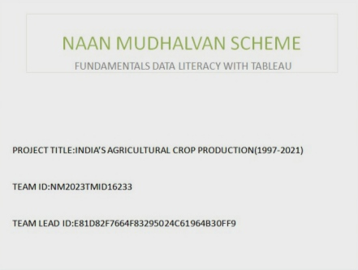

Slide 2


Slide 3
Introduction

Slide 4
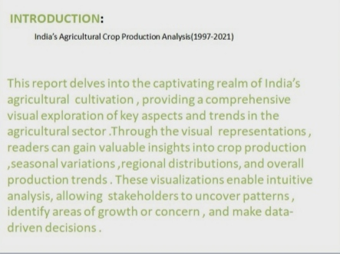

Slide 5
Problem Definition & Design Thinking

Slide 6


Slide 7
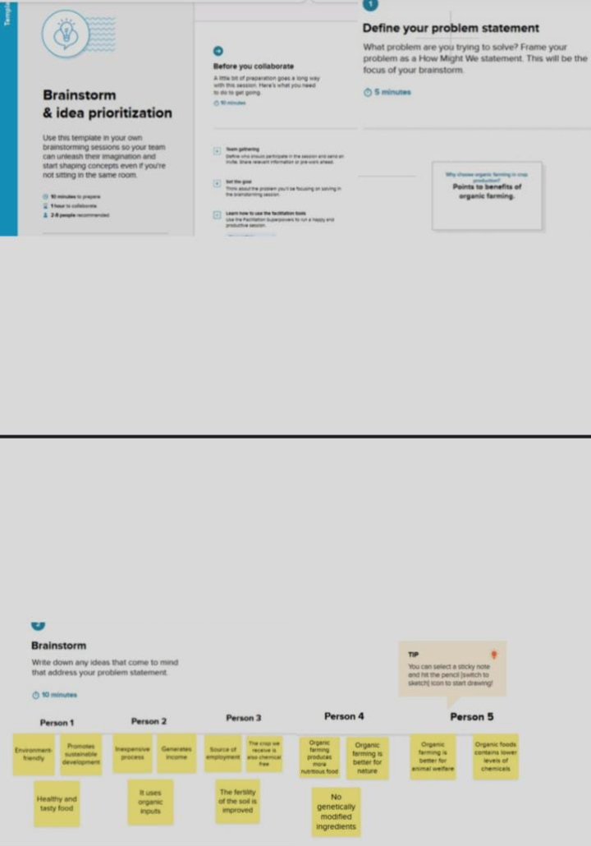

Slide 8
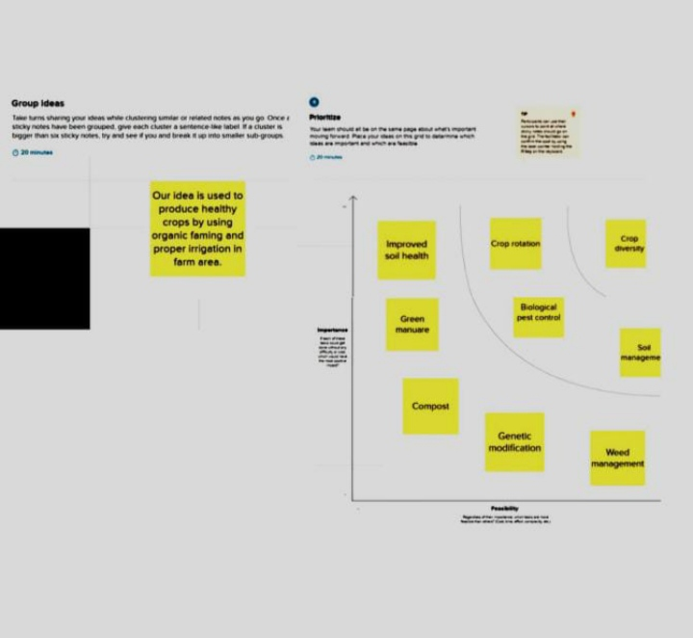

Slide 9
Result

Slide 10
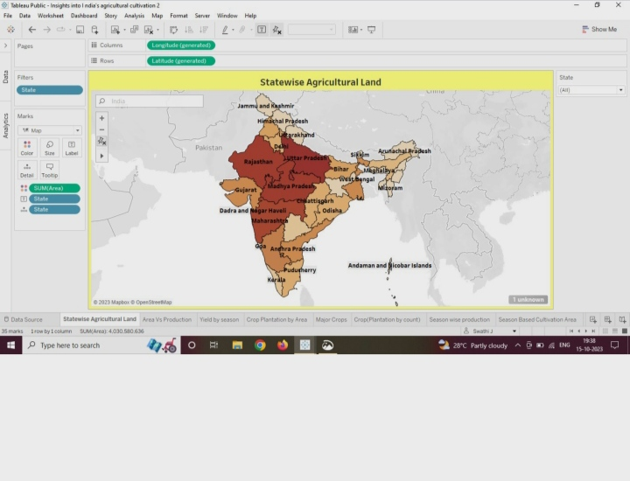
Statewide Agricultural Land
Notes:
Statewide Agricultural Land

Slide 11
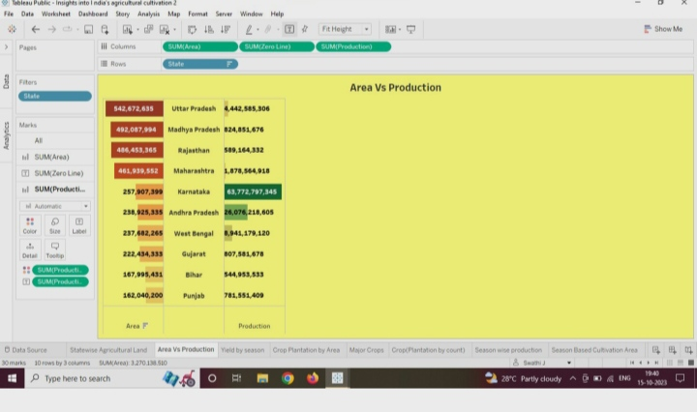
Area Vs Production

Slide 12
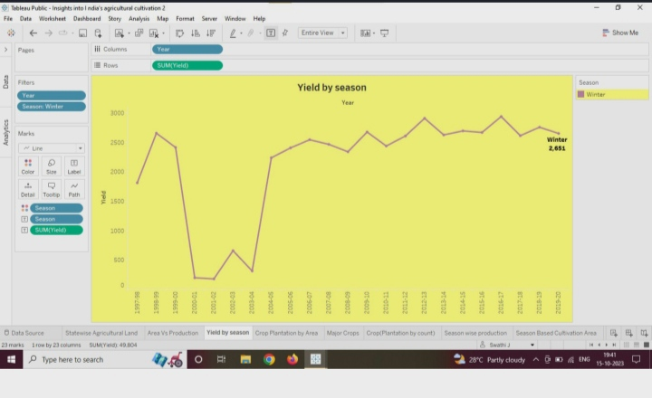
Yield by season

Slide 13
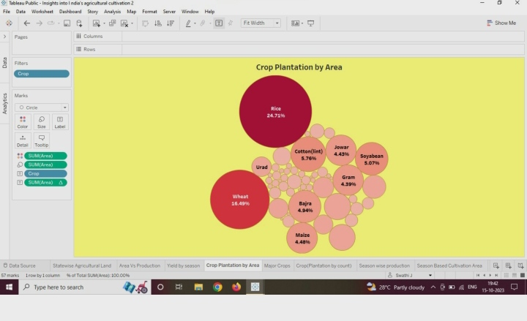
Crop Plantation by Area

Slide 14
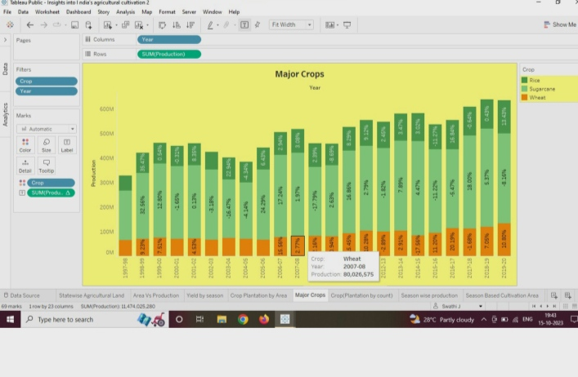
Major crops

Slide 15
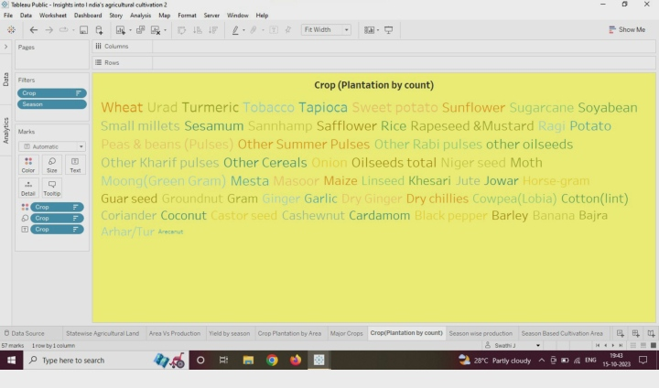
Crop (Plantation by count )

Slide 16
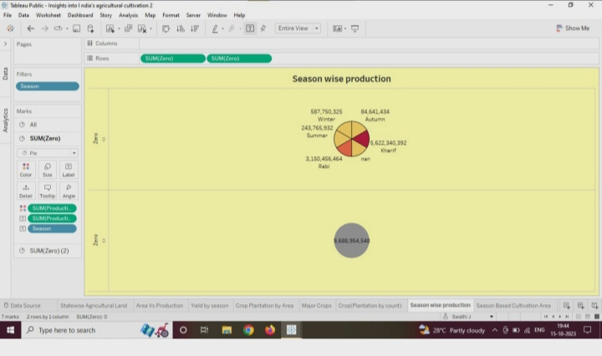
Season wise production

Slide 17
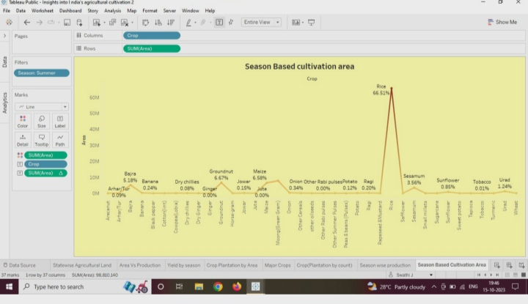
Season Based Cultivation area

Slide 18
DASHBOARD

Slide 19
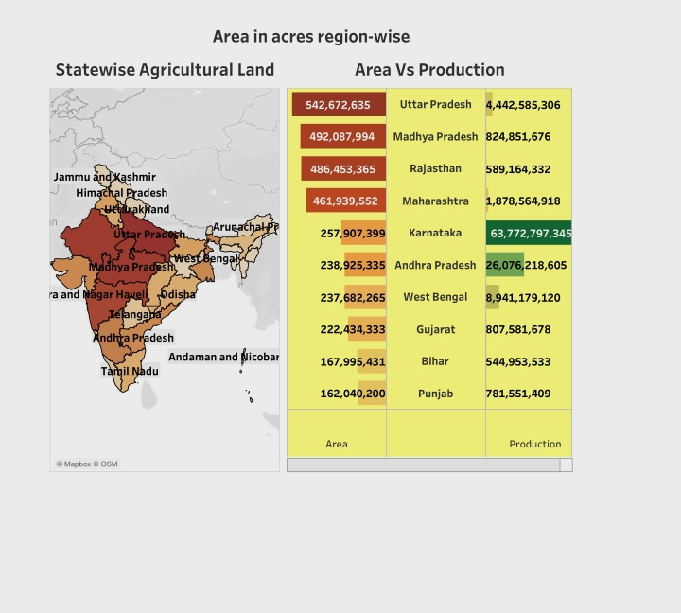
Dashboard 1

Slide 20
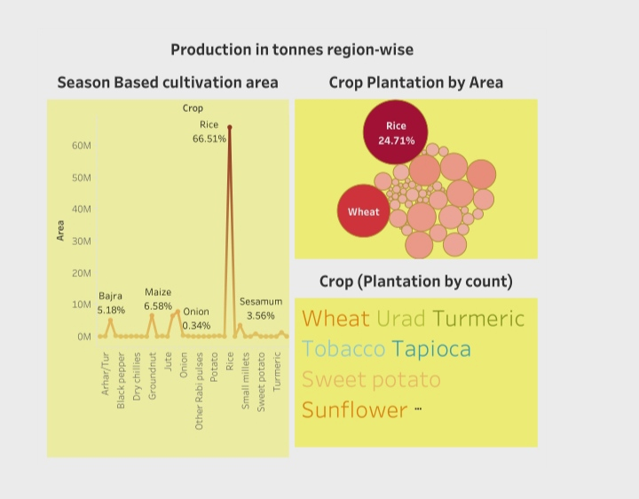
Dashboard 2

Slide 21
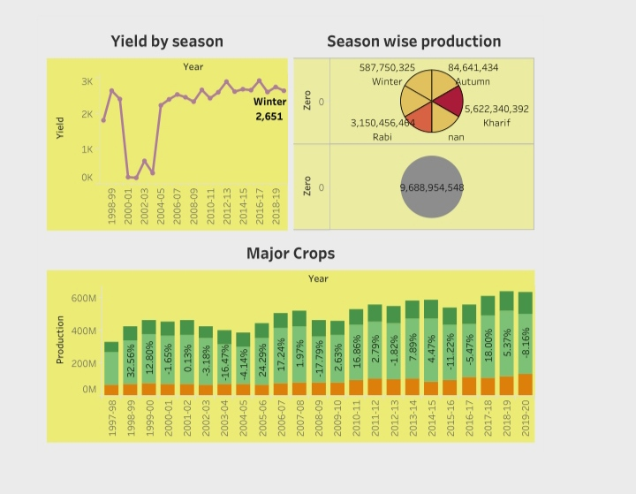
Dashboard 3

Slide 22
STORY

Slide 23
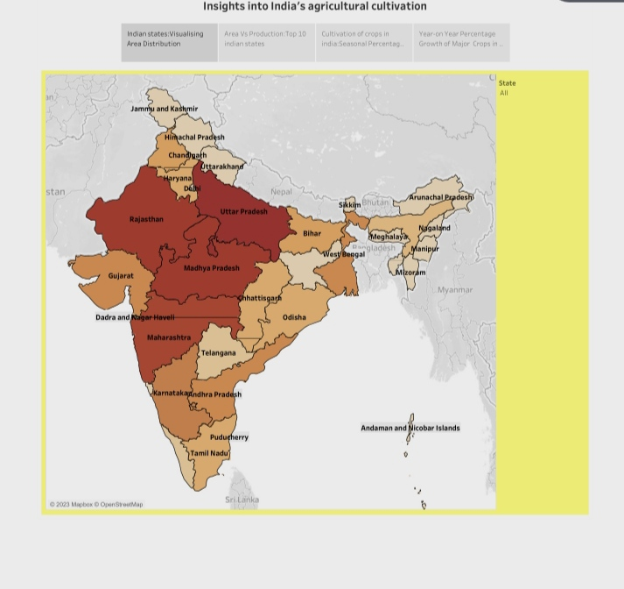
Insights into India‘s agricultural cultivation

Slide 24
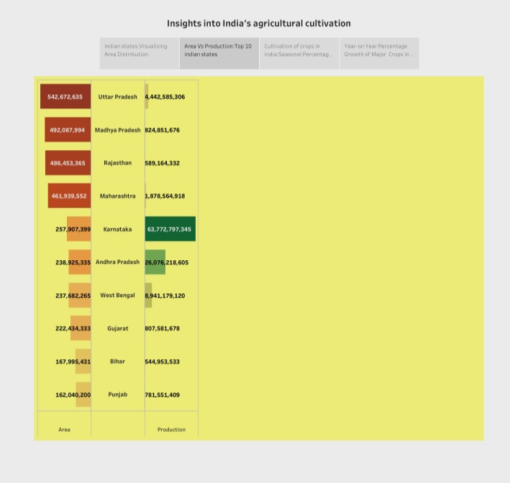
Insights into India’s agricultural cultivation

Slide 25
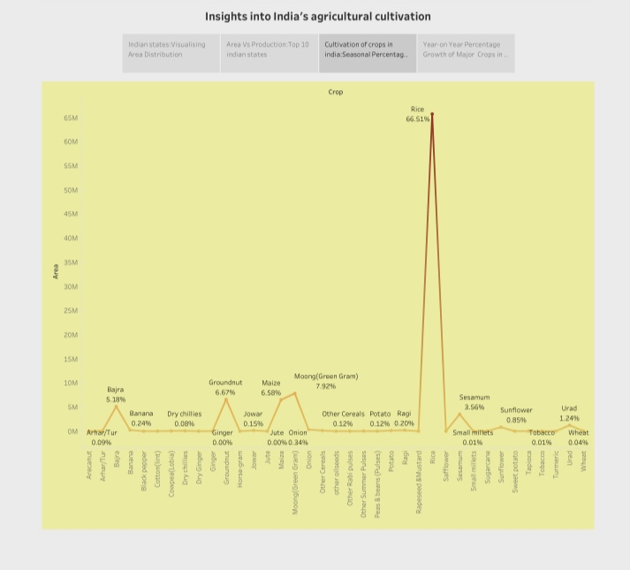
Insights into India’s agricultural cultivation

Slide 26
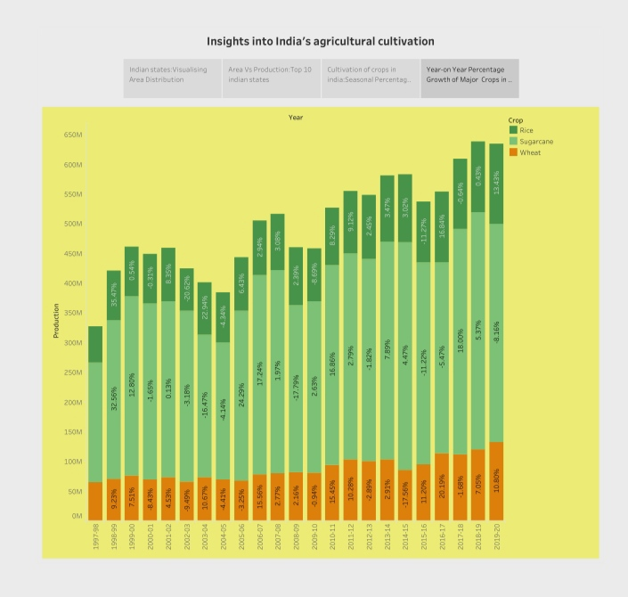
Insights into India’s agricultural cultivation

Slide 27
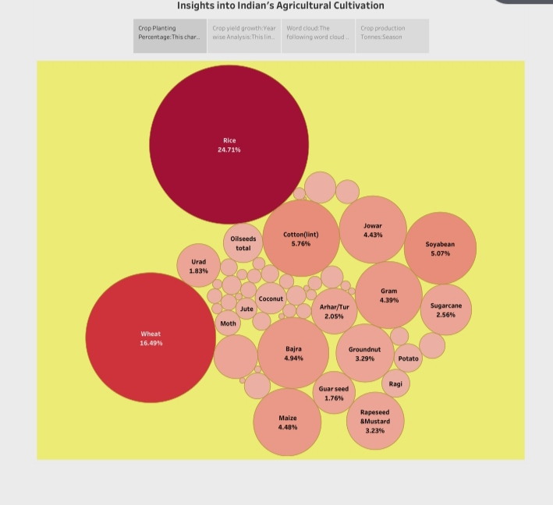
Insights into India’s agricultural cultivation

Slide 28
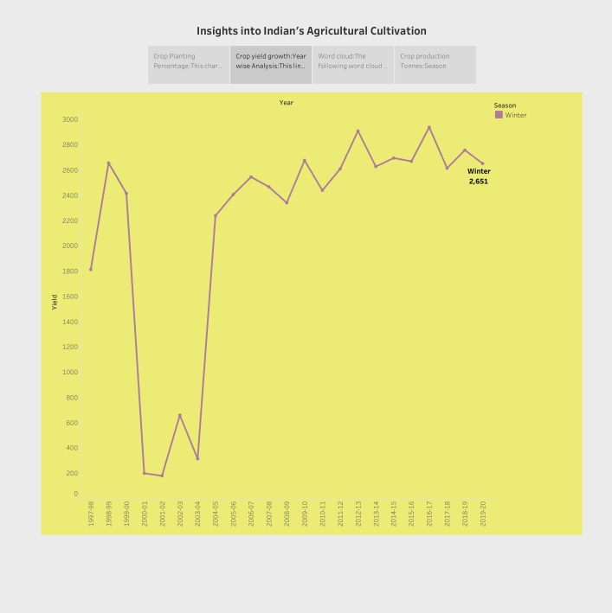
Insights into Indian’s agricultural cultivation

Slide 29
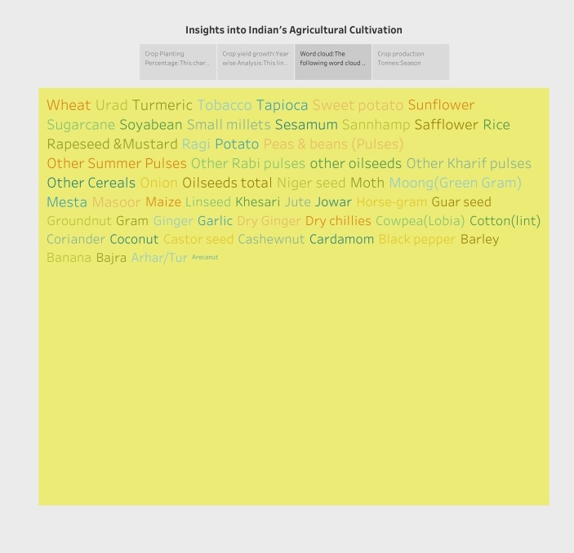
Insights into India’s agricultural cultivation

Slide 30
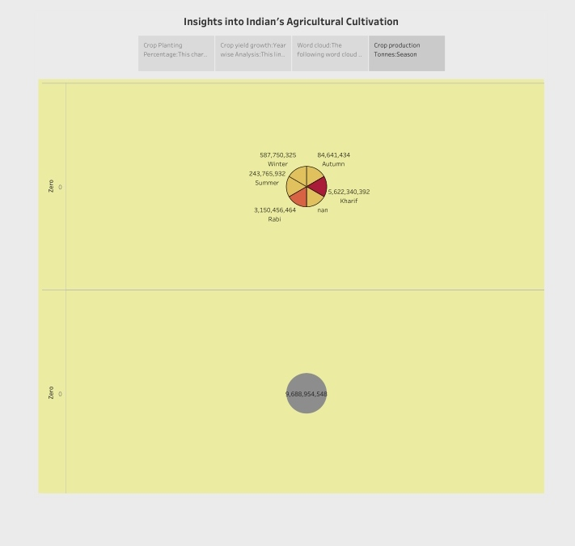
Insights into India’s agricultural cultivation

Slide 31
PUBLISHING

Slide 32


Slide 33
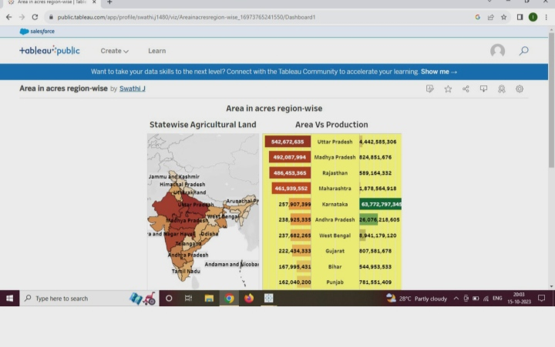

Slide 34
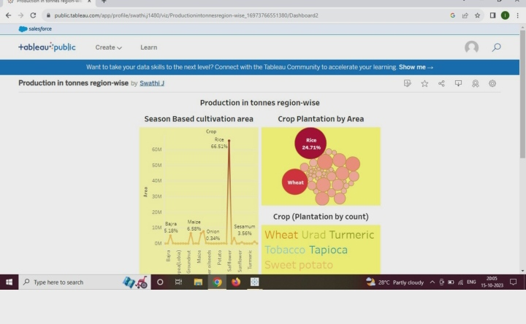

Slide 35
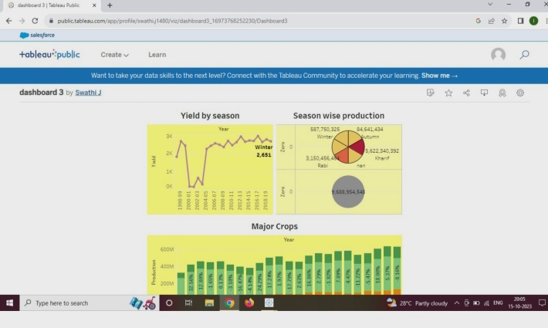

Slide 36
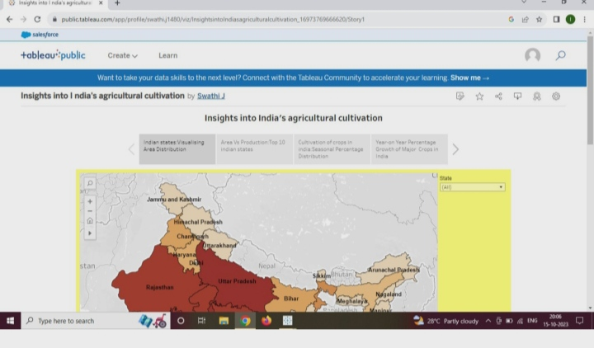

Slide 37
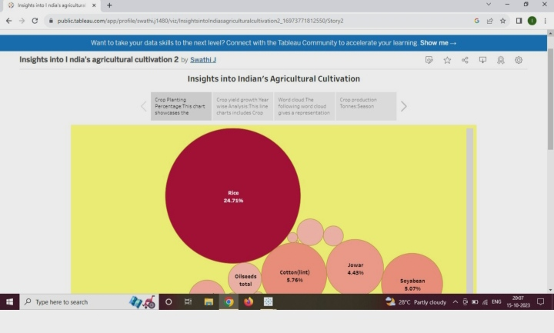

Slide 38
Advantages & Disadvantages

Slide 39
Advantages:
Agriculture supplies raw materials to various agro-based industries like sugar, jute, cotton textile and Vanaspati industries. Food processing industries are similarly dependent on agriculture. Therefore the development of these industries entirely is dependent on agriculture.

Slide 40
Disadvantages:
Erosion of soil by heavy rain, floods, insufficient vegetation cover etc., reduces farm productivity. Inadequate irrigation facilities and poor management of water resources have led to a great decline in agricultural productivity.

Slide 41
Applications
Crop production is the process of growing crops such as grains, fruits, vegetables, and nuts. The goal of crop production is to produce a high yield of quality crops that can be sold or used for food, feed, fuel, and fibre.

Slide 42
Conclusion:
It provides employment opportunity to the rural agricultural as well as non-agricultural labourers. It is the source of food and fodder. It also plays an important role in international business in import and export activities.
Here are some key aspects of the importance of crop production and its impact on the economy: Food Security: Crop production is a primary source of food for human consumption. It ensures a stable and sufficient supply of essential nutrients and calories needed for people to maintain health and well-being.

Slide 43
Future Scope:
The Indian economy is an agro-economy and depends highly on the agricultural sector. Despite just supporting the Indian Economy, the agricultural sector also supports the industrial sector and international trade in imports and exports.
Due to globalisation, increase in household incomes and health consciousness the demand for fruits and vegetables, dairy products, fish and meat is going to increase in future. Research, technology improvements, protected cultivation of high-value greens and other vegetables will be more.

Slide 44
THANK YOU

